Slide 1
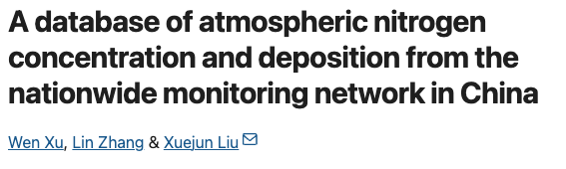

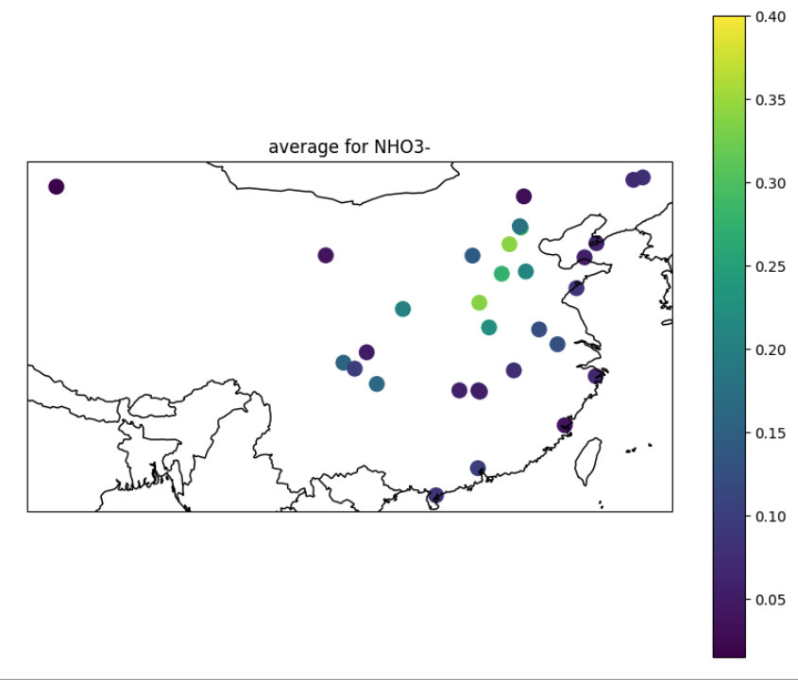
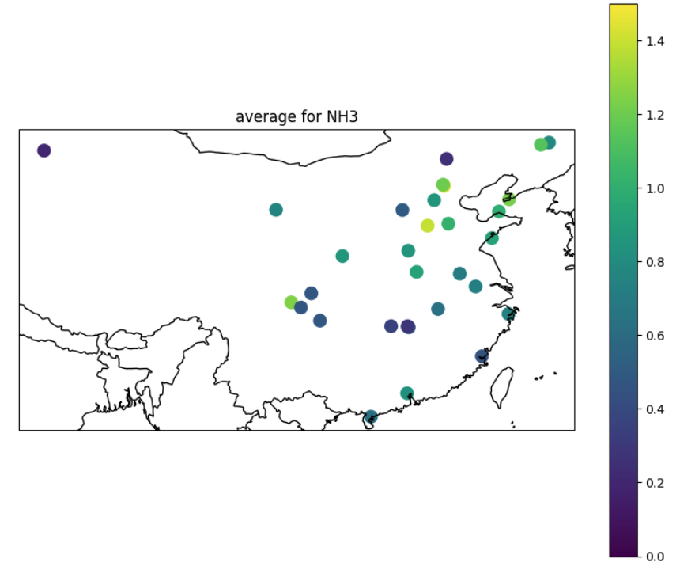
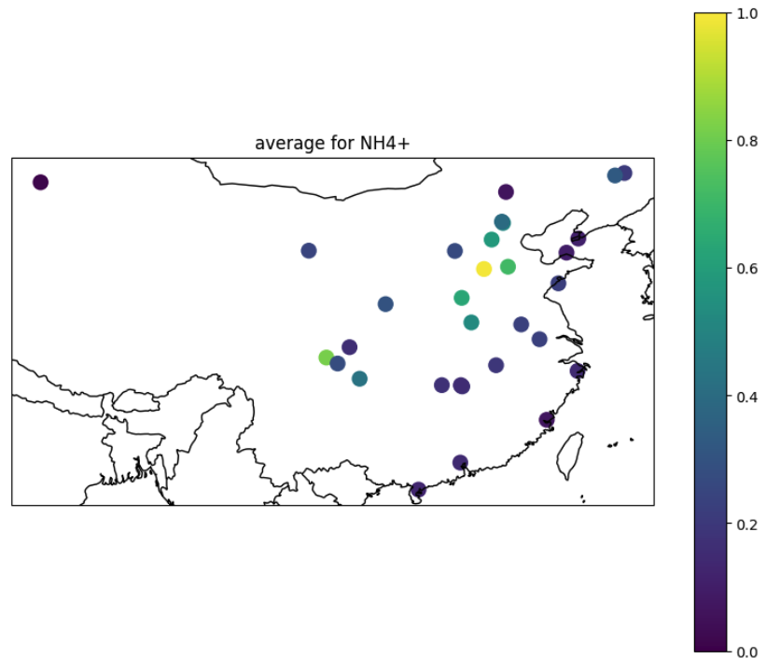
May 2010 – Dec. 2015
monthly mean data
precipitation amount; concentration; dry deposition fluxes for
gaseous NH3, NO2, HNO3
particulate NH4+, NO3-
Notes:
Grouped by land-use type, the annual average dry deposition (1.9–16.6 kg N ha⁻¹ yr⁻¹ for NH₃, 0.2–16.0 kg N ha⁻¹ yr⁻¹ for HNO₃, 0.2–9.5 kg N ha⁻¹ yr⁻¹ for NO₂, 0.1–11.8 kg N ha⁻¹ yr⁻¹ for particulate NH₄⁺, and 0.2–4.1 kg N ha⁻¹ yr⁻¹ for particulate NO₃⁻) and bulk deposition (2.7–18.9 kg N ha⁻¹ yr⁻¹ for NH₄⁺-N, and 1.5–17.4 kg N ha⁻¹ yr⁻¹ for NO₃⁻-N)

Slide 2
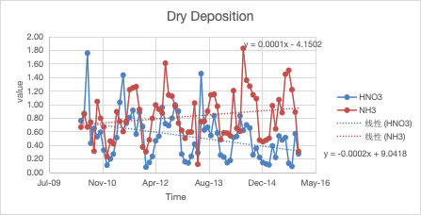
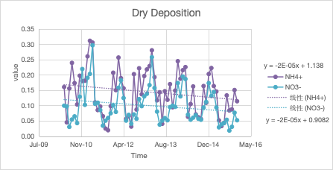
HNO3:
high value in May, June, low fluxes in Dec, Jan, Feb
NH3:
larges fluxes in Aug, low fluxes in Dec, Jan
NO2:
high in Aug, Sept, Oct, (Nov)m low in (Dec), Jan, Feb
NH4+:
a bit random
high in Feb, Mar, Apr, low in Jun, July, (Sept, May)
NO3-:
high in Mar, Apr. (Jan, Feb), low in June, July (Sept, Oct)

Slide 3
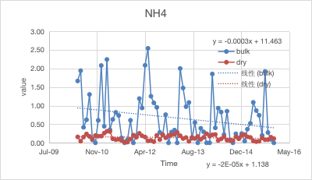
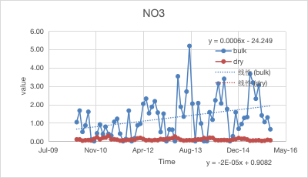
NH4+
largest dry deposition in
Feb, Mar, Apr
Largest bulk deposition most frequent in May
NO3-
largest dry deposition in
Mar, Apr
Largest bulk deposition most frequent in May
Notes:
相较2011，2012年，14，15年一月份dry deposition更大
Generally bulk_NO3 > bulk_NH4

Slide 4

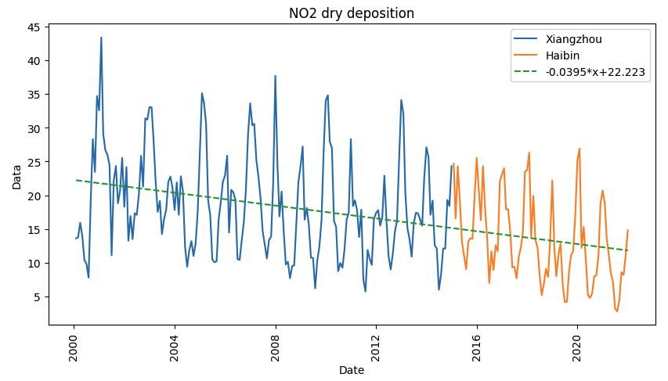
2000-2022
Peaks in winter,
Dec., Jan.
Low in spring,
Apr., May
correlation coefficient = -0.404
p-value = 9.1e-12
Units in ppb
Notes:
https://monitoring.eanet.asia/document/public/index
Correlation coefficient (r): -0.40363006250617633 P-value: 9.14057587989423e-12

Slide 5
wet deposition Xiangzhou
abnormal high in 2007
NO3-:
slight increase over the years
no signifiacant seasonal trend,
large deposition fluxes most frequent in May
low in winter, Dec, Jan
NH4+
a little bit decrease
peaks in spring and summer
low in winter, Oct, Nov, dec, Jan, Feb
y = 7E-05x + 0.1825
y = -0.001x + 48.41
units: mmol/m^2
Notes:
No significant seasonal trend

Slide 6
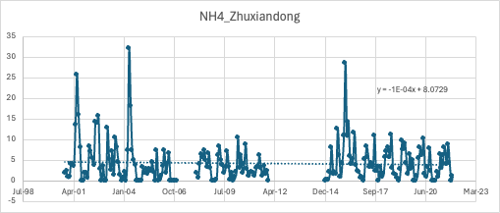
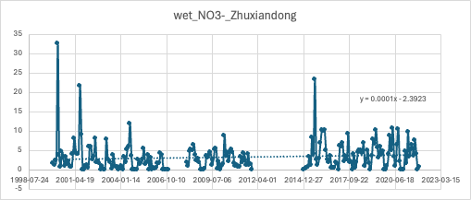
gtgvv

Slide 7
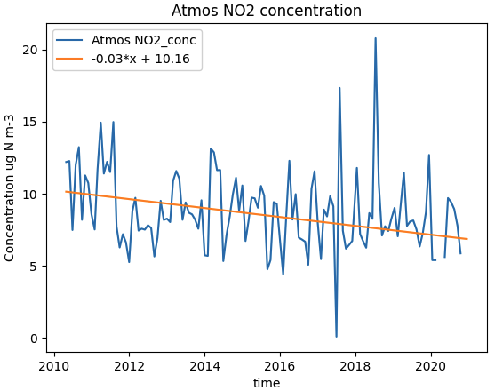
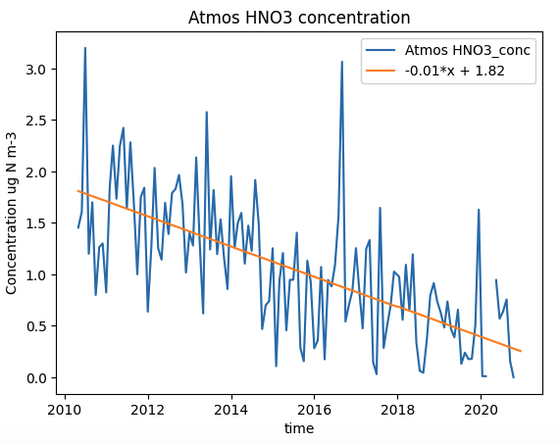
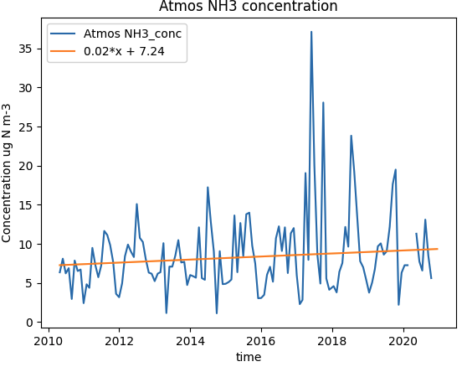
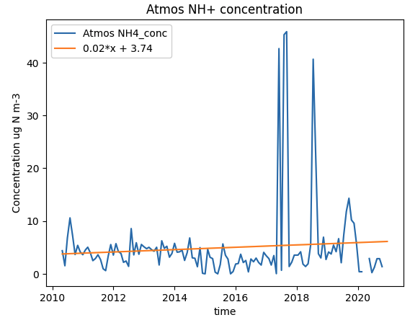
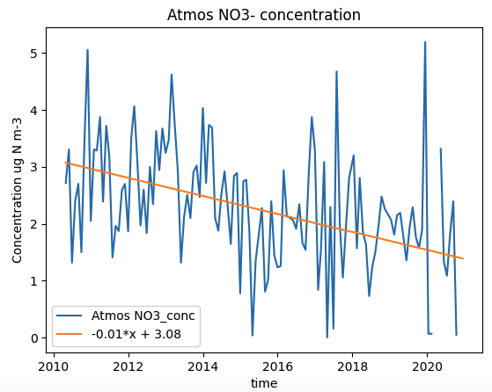
Atmos Nr concentration

Slide 8
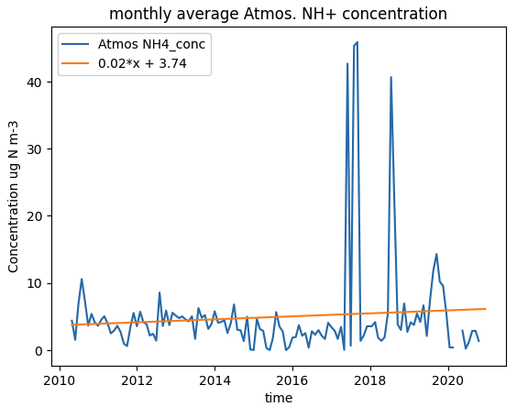
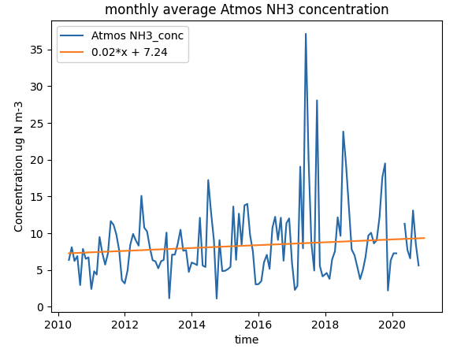
←
201706
201706;
201708-09
→
→
201807
201710
201807

Slide 9
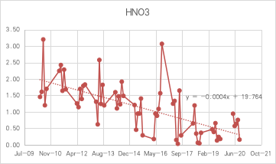
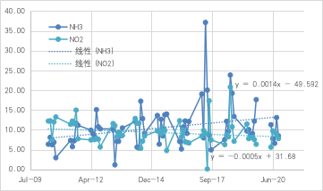
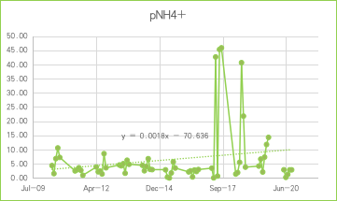
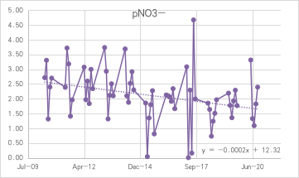
April – Sept. (atmos. Conc.)

Slide 10
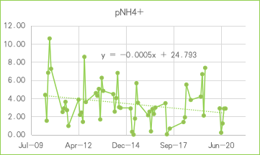
Deleted
2017-06,2017-08,2017-09
2018-072018-08
2019-08

Slide 11
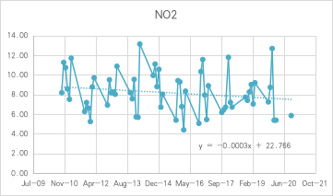
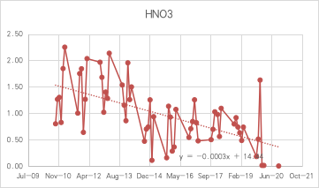
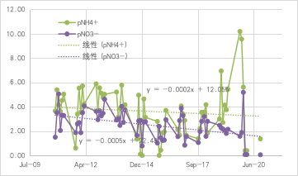
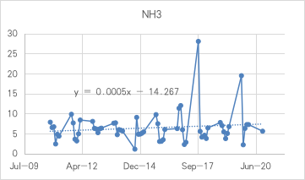
Oct-Mar

Slide 12
monthly dry deposition
Notes:
Dry Deposition / kg N ha-1

Slide 13
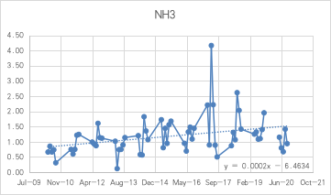
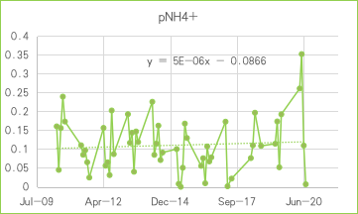
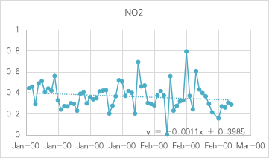
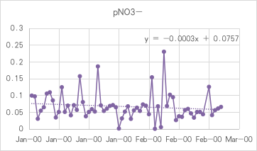
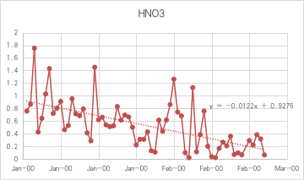
April-Sept

Slide 14
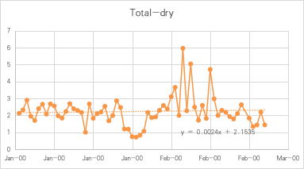
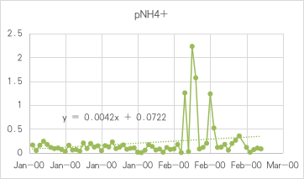

Slide 15
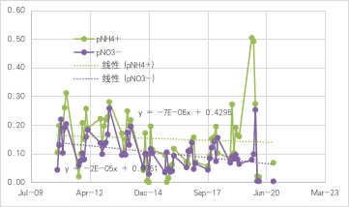
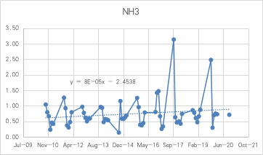
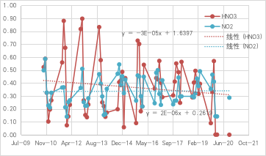
Oct-Mar

Slide 16
wet-deposition
increase in tot wet deposition,
decrease in tot wet+dry deposition

Slide 17
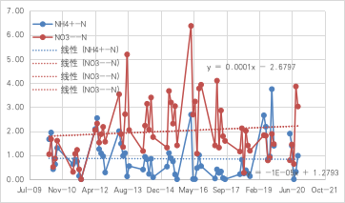
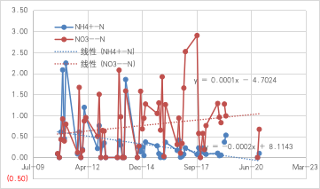
April-Sept
Oct-Mar

Slide 19
annual atmospheric concentration
increased concentration of NH3 and NH4+

Slide 20
annual dry deposition sum
increased dry deposition of NH3 and NH4+

Slide 21
decreased NH4+ wet deposition;
increased total wet deposition

Slide 25
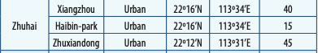
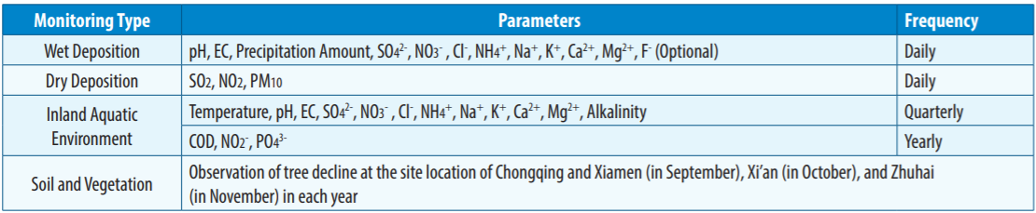
2000-2022 monthly and annual data
dry deposition for Xiangzhou (2001-2016) and Haibin (2016-2022)
wet depostion for Xiangzhou (2000-2022) and Zhuxiandong (missing 2007, 2012, 2013, 2014)
Notes:
https://monitoring.eanet.asia/document/public/index
Correlation coefficient (r): -0.40363006250617633 P-value: 9.14057587989423e-12

Slide 26
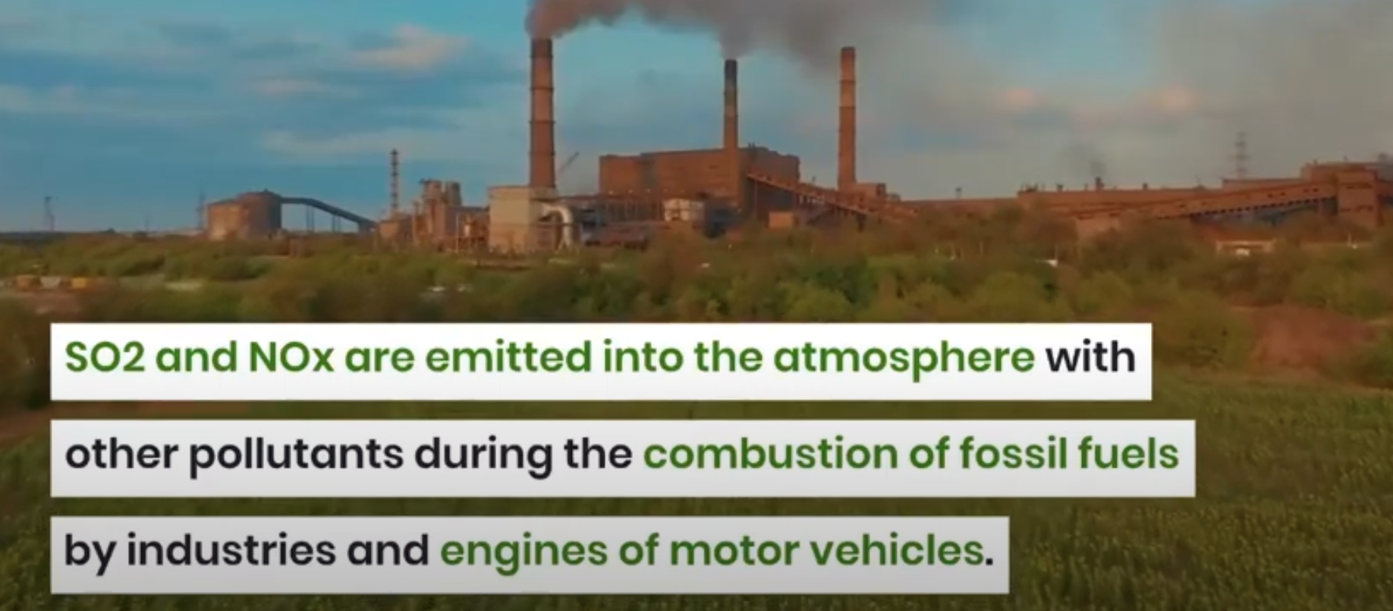
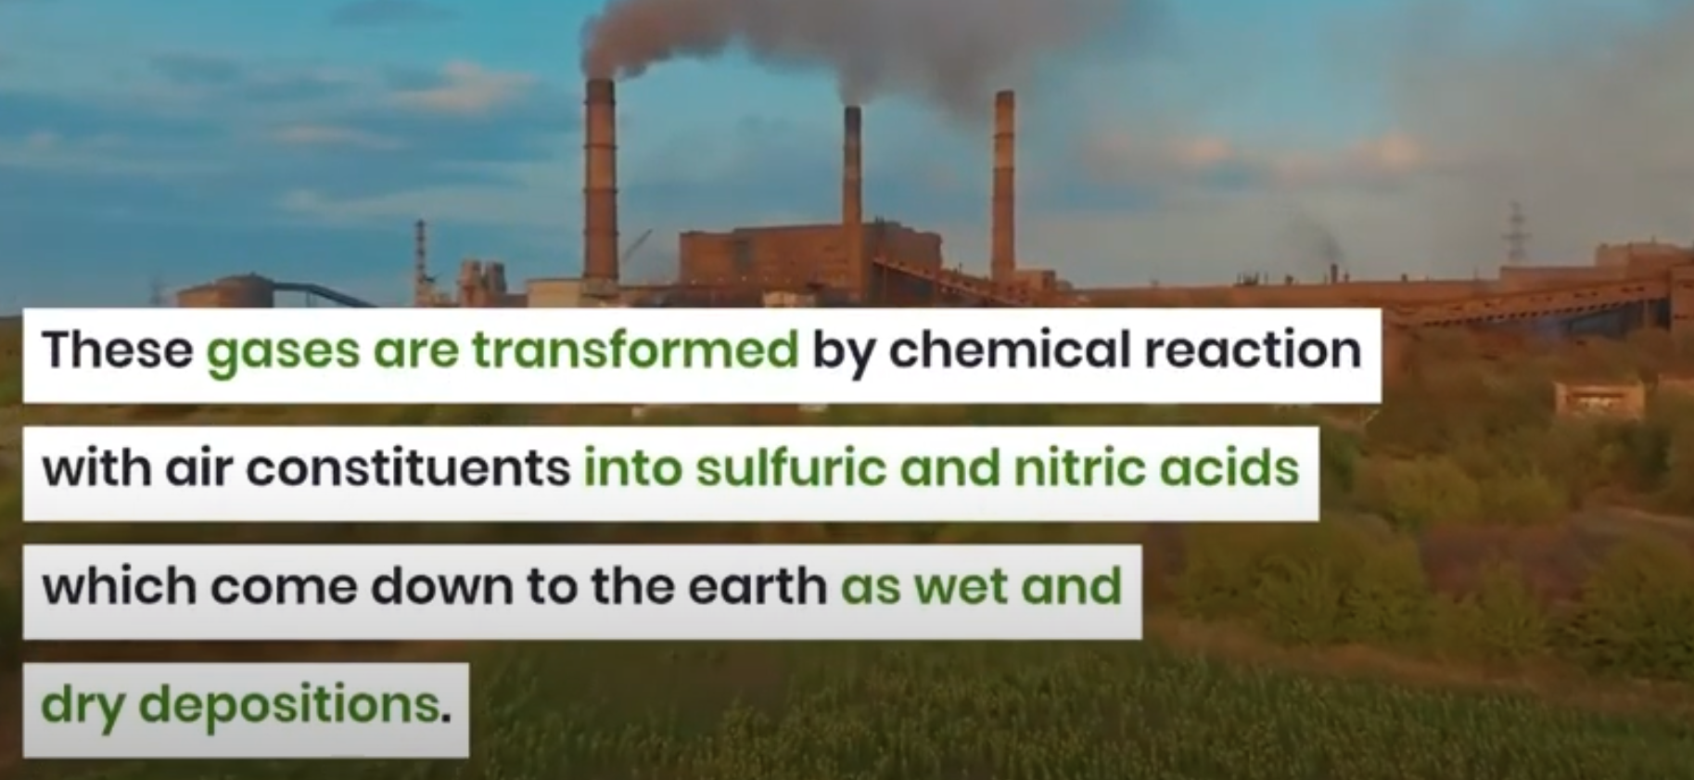
https://www.youtube.com/watch?v=j5rH-D0fr_I

Slide 27
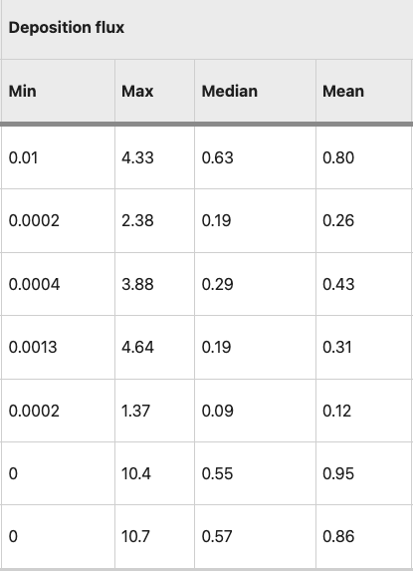
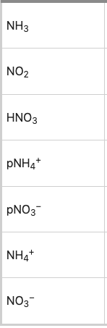
For 32 sites
kg N ha−1 month−1
https://www.nature.com/articles/s41597-019-0061-2/tables/2

